Slide 1
ICS 104 - Introduction to Programming in Python and C
Files and Exceptions

Slide 2
Files and Exceptions
Reading Assignment
Chapter 7 Sections 1, 2 and 5.
Chapter Learning Outcomes
At the end of this chapter, you will be able to
read and write text files
process collections of data
raise and handle exceptions

Slide 3
Reading and Writing Text Files: Opening a File for Reading
To access a file, you must first open it.
When you open a file, you give the name of the file.
If the file is stored in a different directory, the file name is preceded by the directory path.
You also specify whether the file is to be opened for reading or writing.
infile = open("input.txt","r")

Slide 4
Reading and Writing Text Files: Opening a File for Reading
infile = open("input.txt","r")
This statement opens the file for reading (indicated by the string argument "r") and returns a file object that is associated with the file input.txt.
Stores the file object in a variable infile
When opening a file for reading, the file must exist or an exception is raised.

Slide 5
Reading and Writing Text Files: Opening a File for writing
To open a file for writing, use the following statement
outfile = open("output.txt","w")
If the output file already exists, it is emptied before the new data is written into it.
If the file does not exist, an empty file is created.
All operations for accessing a file are made via the file object.

Slide 6
Reading and Writing Text Files: Closing Opened Files
When you are done processing a file, be sure to close the file using the close method:
infile.close()
outfile.close()
If your program exits without closing a file that was opened for writing, some of the output may not be written to the file.

Slide 7
Reading and Writing Text Files
The name of the file to open
infile = open("input.txt", "r")
outfile = open("output.txt", "w")
Read data from infile.
Write data to outfile.
infile.close()
outfile.close()
Store the returned file objects in variables.
Specify the mode for the file:
"r" for reading (input)
"w" for writing (output)
Close Files after the
data is processed
If you fail to close an output file, some data may not be written to the file.

Slide 8
Reading a File
To read a line of text from a file, call the readline() method on the file object that was returned when you opened the file.
When a file is opened, an input marker is positioned at the beginning of the file.
The readline method reads the text, starting at the current position and continuing until the \n character is encountered. \n character denotes end of line.
The input marker is then moved to the next line.
The readline method returns the text that it reads, including the \n character that denotes end of line.

Slide 9
Reading a File
For example, suppose input.txt contains the lines
flying
circus
not
flying
circus

Slide 10
Reading a File
flying
circus
flying
The length of line1 is 7
circus
The length of line2 is 7
The length of line3 is 0
# A sample use of readline
infile = open("input.txt","r")
line1 = infile.readline()
print(line1 + "The length of line1 is", len(line1))
line2 = infile.readline()
print(line2 + "The length of line2 is", len(line2))
line3 = infile.readline()
print(line3 + "The length of line3 is", len(line3))
infile.close()

Slide 11
Reading a File
flying
circus
The first call to readline returns the string "flying\n".
Recall that \n denotes the newline character that indicates the end of the line.
If you call readline a second time, it returns the string "circus\n".
Note that there is "\n" since there is an empty line after this line in the text file.
Calling readline again yields the empty string "" because you have already reached the end of file marker.

Slide 12

An Activity: Try it with the other input file
# A sample use of readline
infile = open("input.txt","r")
line1 = infile.readline()
print(line1 + "The length of line1 is", len(line1))
line2 = infile.readline()
print(line2 + "The length of line2 is", len(line2))
line3 = infile.readline()
print(line3 + "The length of line3 is", len(line3))
infile.close()
flying
circus

Slide 13
Reading multiple lines of a file
Reading multiple lines of text from a file is very similar to reading a sequence of values with the input function.
You repeatedly read a line of text and process it until the sentinel value is reached:
infile = open("input.txt","r")
line = infile.readline()
print(line, end="")
while line !="" :
line = infile.readline()
print(line, end="")
print()
infile.close()
flying
circus

Slide 14
Reading from file
As with the input function, the readline method can return only strings.
If the file contains numerical data, the strings must be converted to the numerical value using the int or float function:
For example:
value = float(line)

Slide 15
Writing a File
You can write text to a file that has been opened for writing.
This is done b applying the write() method to the file object.
For example, we can write the string "Hello, World" to our output file using the statement:
outfile = open("output.txt","w")
outfile.write("Hello, World!\n")
outfile.close()

Slide 16
A File Processing Example
Suppose you are given a text file that contains a sequence of floating-point values, stored one value per line.
You need to read the values and write them to a new output file, aligned in a column and followed by their total and average values.

Slide 17
A File Processing Example
Output file
Given a text file with a sequence of floating-point values, one value per line.
read the values and write them to a new file, aligned in a column and followed by their total and average.
32.00
54.00
67.50
80.25
115.00
--------
Total: 348.75
Average: 69.75
Input file
32.0
54.0
67.5
80.25
115.0

Slide 18
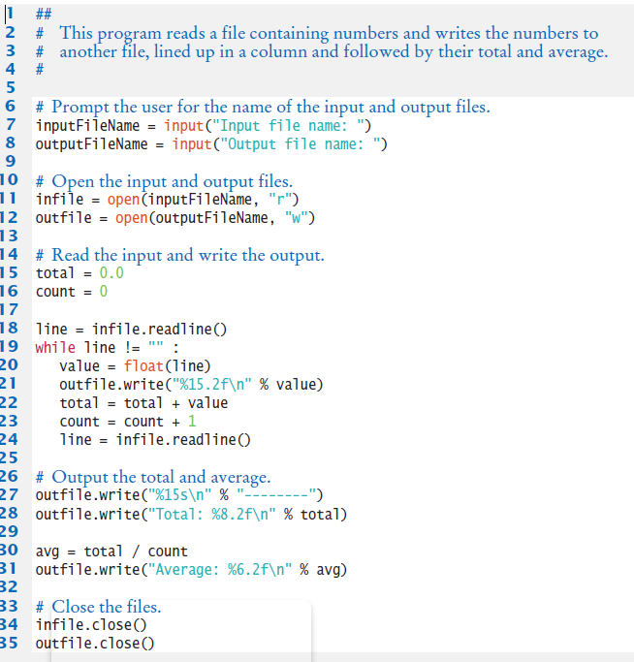

Slide 19
A File Processing Example
# Prompt the user for the name of the input and output files.
inputFileName = input("Input file name: ")
outputFileName = input("Output file name: ")
# Open the input and output files.
infile = open(inputFileName, "r")
outfile = open(outputFileName, "w")

Slide 20
A File Processing Example
# Read the input and write the output.
total = 0.0
count = 0
line = infile.readline()
while line != "" :
value = float(line)
outfile.write("%15.2f\n" % value)
total = total + value
count = count + 1
line = infile.readline()

Slide 21
A File Processing Example
# Output the total and average.
outfile.write("%15s\n" % "--------")
outfile.write("Total: %8.2f\n" % total)
avg = total / count
outfile.write("Average: %6.2f\n" % avg)
# Close the files.
infile.close()
outfile.close()

